Slide 1

[AIS] IPTV Pre-PoC plan

Slide 2
1. PoC Topic
1. PoC Topic
Headend Integration Testing CMS
MW Proxy
Authentication /Authorization
Purchasing
Concurrency
PDPA
Super Aggregation
Frontend UI/UX ( shelf Management)
Advertisement
IOT
TV Shopping
Analytic
Recommendation
Operation
2. PoC location and contact information
POC is held on the 20th floor of the Pearl Building
The order of each bidder for POC is coordinated by the MMT project manager.
Meeting invitations will be sent via email once the order is confirmed, questions can be directed to Mr. Sithiphon
3. RFP Schedule
1. RFP and POC document open for all participants on July 10th
2. As of July 17: All participants must submit VDO's API and related configuration documents to MMT, which must all be set as MMT Middleware. MMT will complete the configuration application by July 21st and provide a configuration report that all participants must integrate the middleware API documentation and detailed workflow, VOD assets for testing, live playback URLs, etc.

Slide 3
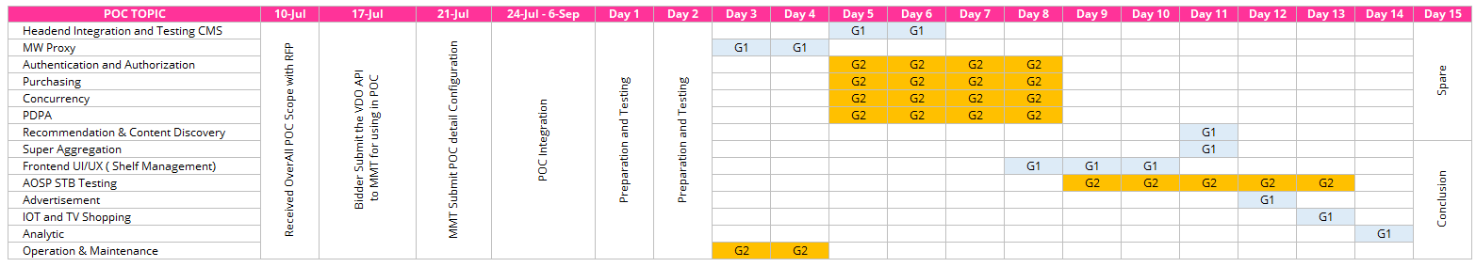
2. PoC Schedule Plan (1/2)
1. PoC Integration Step : 7/24 ~ 9/6
2. PoC : 9/11 ~ 11/17

Slide 4
3. Pre-PoC schedule (2/2)
Pre Poc Schedule
Category | Activity | ~Aug.10 | Aug.11 | Aug.14 ~ Aug.18 | Aug.18 ~Aug.25 | Sep.01 | 9/06 | ~Sep.30
Plan | Preparing PoC Plan design | ALL
Setup | Preparing AWS accounts and preparing projects | KTds & MZC
IAM & Role mgmt. | AWS account and permission management (users, groups) |  | KT DS | KT DS
AWS Infrastructure | Configuring VPC, Network, S3, Bastion Server, EKS Controller Server Environment |  | MZC
 | EKS Cluster and Node Configuration |  | MZC
 | K8s Required Object Configuration (CNI, CSI, Metric Server, AWS Load Balacer Controller) |  | MZC | MZC
 | PoC Infrastructure Analysis/Design |  |  | KTDS/ MZC | KTDS/ MZC | KTDS/ MZC | MZC | KTDS/ MZC
Implements & Deploy(CI/CD | Change application settings and deploy docker build/registration |  |  | KT DS | KTDS
 | K8s Object File Distribution (Deployment, Services, Input, etc.) CI/CD pipeline configuration and installation of other solutions such as APM (not for PoC) |  |  | KT DS | KTDS
Unit Test | service function check |  |  |  | ALL
Regression test | Local API testing in Thailand |  |  |  | ALL
Result | Review Results |  |  |  |  |  | KT DS

Slide 5
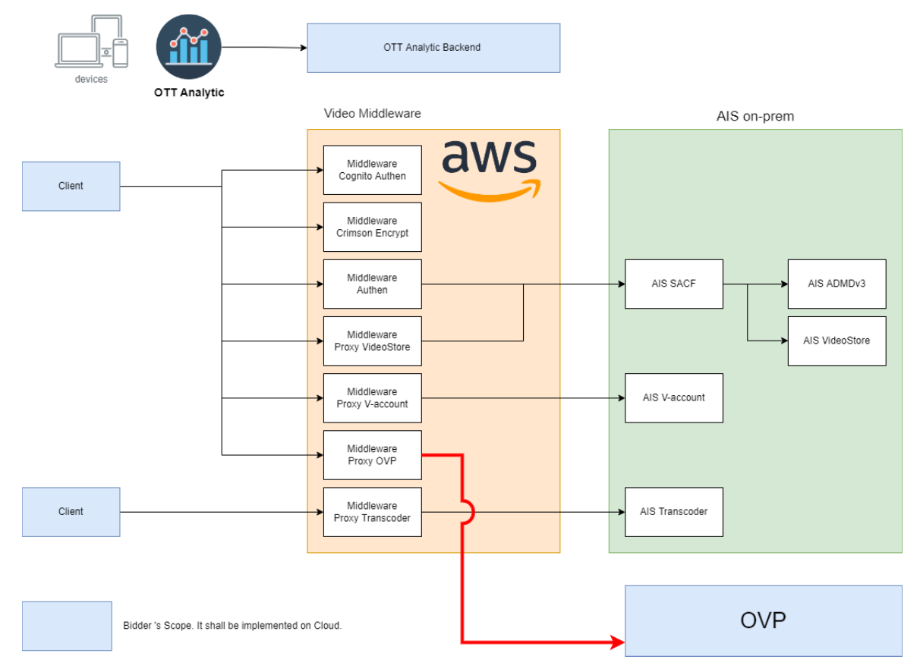
4. PoC Architecture
PoC Architecture
This POC should be based on the same architecture as the production environment Namely. Nearly 100% of the business logic is controlled by MMT middleware. In other words, it is recommended that the diagram be studied as a reference to all POC test cases throughout this document As described in the POC Schedule section, participants must provide and resubmit the VDO API and associated configurations that require MMT to be configured in middleware. This is indicated by a red line in the figure.

Slide 6
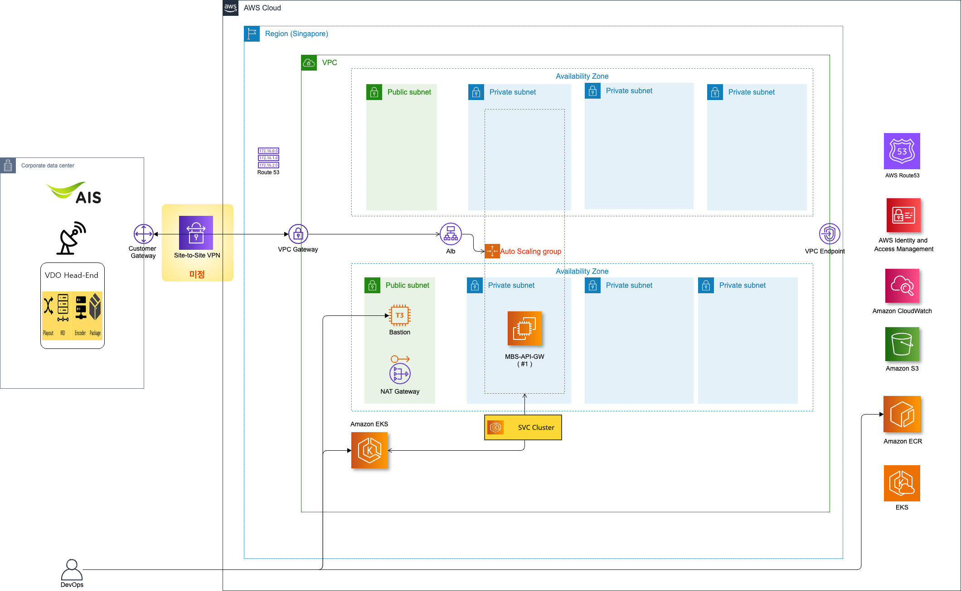
5. Pre- PoC Architecture Draft
Pre PoC Architecture
AWS Infra and Network Environment Configuration Singapore (ap-southeast-1)
EKS Cluster and Single Worker Node Configuration for API Testing
- Cluster name: ais-poc-eks-cluster
- in the aws-auth Configmap
kt-eks-admin Registered and available
External developer installs kubectl on Bastion server for testing EKS API commands and deployment
Bastion IP: 13.228.88.222
Bastion Username: ec2-user
AWS Key Pair Name: ais-poc-keypair.
(Key for server access will be provided separately)

Slide 7
6. Pre-PoC Scenario -Auto Login

Slide 8
6. Pre- PoC Scenario. – HBA Login

Slide 9
7. Pre-PoC Check List
항목 | 내용
AWS account (new or existing) information | Account ID : 803385727533
VPC network band definition by environment | PoC VPC Network Range VPC(ais-poc-vpc) : 10.0.0.0/16 Subnet (Design considering actual operating environment IP range) ais-poc-subnet-pub-01a : 10.0.0.0/22 (pre-poc , 1024 IP Range) ais-poc-subnet-pub-02c : 10.0.4.0/22 (pre-poc , 1024 IP Range) ais-poc-subnet-pri-svc-01a : 10.0.8.0/21 (pre-poc , 2048 IP Range) ais-poc-subnet-pri-svc-02c : 10.0.16.0/21 (pre-poc , 2048 IP Range)
PoC domain and certificate | Domain : newovp-platform.com Certificatino : aws certification
Naming Rule | Provide Naming Rule policy: ‘group company_environment_host name’ => ‘ais_poc_db’ (example)
Configuring AWS access through bastion (EC2 for tunneling) | use port 22

Slide 10
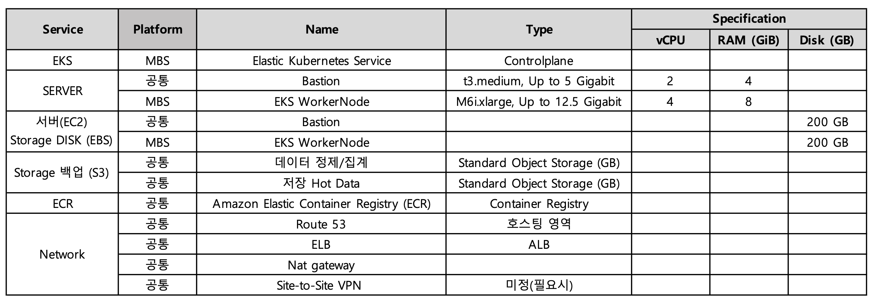
8. Pre-PoC Resource Details

Slide 11
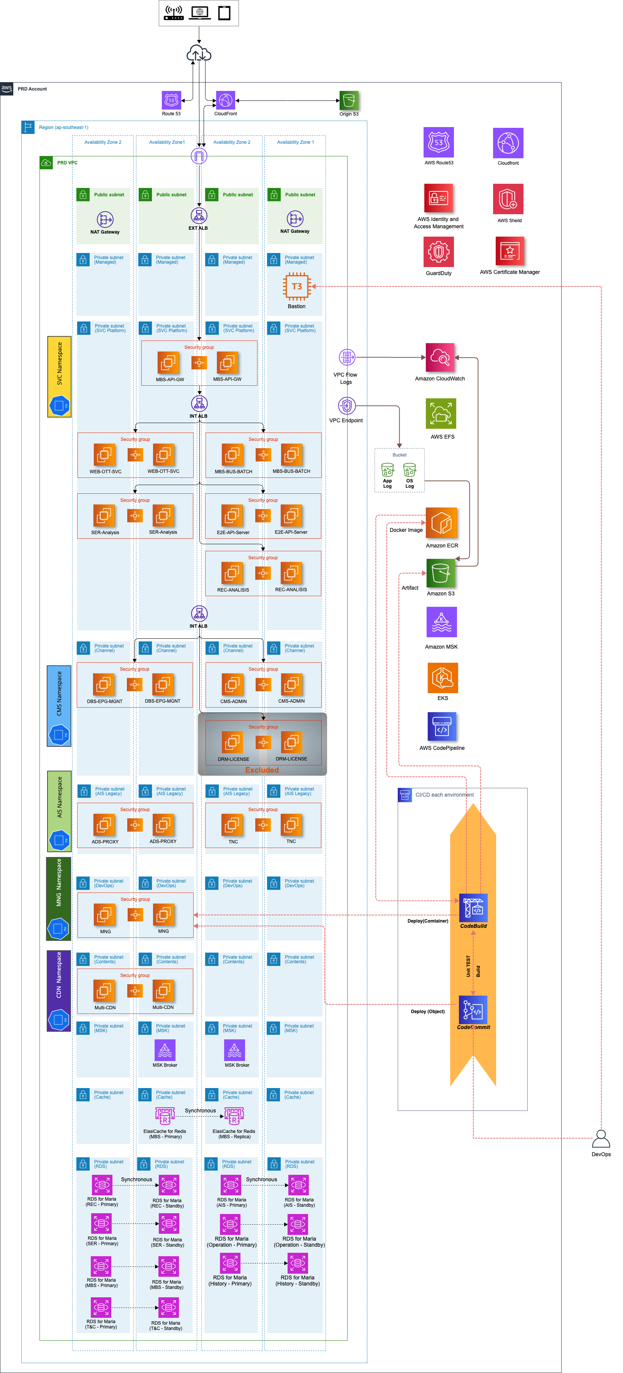
Adx. PoC Infra – PoC(Sep 11 ~ Nov 17)
PoC Architecture
SVC Namespace, CMS Namespace , AIS Namespace ,
MNG namespace , CDN Name space
AWS NAT IP (multi-cdn, ad-proxy)
: A Zone : 122.248.198.147
: C Zone: 18.136.134.14
Interworking AIS AWS Infra - 3BB Staging
AWS NAT IP (multi-cdn, ad-proxy)
Multi CDN – ‘3BB Staging CDN’ for VOD & Channel Content
AD-Proxy – ‘3BB Staging AD’ for AD decision & AD report
OTT & STB – ‘3BB Staging Image Server’ for image & streaming
- A Zone NAT IP : 122.248.198.147
- C Zone NAT IP: 18.136.134.14

Slide 12
Apx. PoC Resource Details(product)

Slide 13
Apx. PoC Resource Details (1/6)
Division | Platform | Service Div | 구분 | 서비스명 | Type | Qty | Size (time) | Specification |  | 비고
 |  |  |  |  |  |  |  | vCPU | MEM (GB)
PoC (Real) | 공통 | 공통 | EKS | Elastic Kubernetes Service | Controlplane | 1 | 732 |  |  | EKS 클러스터 당 고정요금
 | Contents/Channel Management | CMS | EC2 | CMS-Admin | c6i.4xlarge, 12500 Megabit | 2 | 732 | 16 | 32 | OS: AWS Linux 기준
 |  |  | EC2 | CMS-CaptureStation
 | AIS Legacy (Channel/Contents) | ADS | EC2 | ADProxy-Backend | c6i.4xlarge, 12500 Megabit | 2 | 732 | 16 | 32
 |  |  | EC2 | ADProxy-Frontend
 |  |  | EC2 | ADProxy-Statistic And Report
 |  |  | EC2 | ADProxy-Admin Portal
 | Service Platform | Analytics & Multi-CDN | EC2 | Multi-CDN Controller | c6i.4xlarge, 12500 Megabit | 2 | 732 | 16 | 32
 |  |  | EC2 | Analytics-Frontend
 |  |  | EC2 | Analytics Gateway
 |  |  | EC2 | Analytics DB
 | Service Platform | Web Service | EC2 | Web OTT Service - WAS | c6i.4xlarge, 12500 Megabit | 2 | 732 | 16 | 32
 | Contents/Channel Management | DBS | EC2 | EPG Management | c6i.4xlarge, 12500 Megabit | 2 | 732 | 16 | 32
 |  |  | EC2 | SDnS
 | Service Platform | REC | EC2 | Log collection, analysis server | c6i.4xlarge, 12500 Megabit | 2 | 732 | 16 | 32
 |  |  | EC2 | Recommended Learning Server
 |  |  | EC2 | Middleware (WAS)
 |  |  | EC2 | Metadata processing server
 |  |  | EC2 | Referral index server
 |  |  | EC2 | Recommendation service server
 |  |  | EC2 | Recommended management tool server
 |  |  | RDS | Recommended DB server, RDS for MariaDB | db.m6i.2xlarge | 2 | 732 | 8 | 32 | 임의산정한 인스턴스
 | Service Platform | SER | EC2 | Log collection, analysis server | c6i.4xlarge, 12500 Megabit | 2 | 732 | 16 | 32
 |  |  | EC2 | Auto-completion, real-time search service server
 |  |  | EC2 | Middleware (WAS)
 |  |  | EC2 | Metadata processing server
 |  |  | EC2 | search index server
 |  |  | EC2 | Integrated search service server
 |  |  | EC2 | Search Admin Server
 |  |  | RDS | Search DB Server, RDS for MariaDB | db.m6i.2xlarge | 2 | 732 | 8 | 32

Slide 14
Apx. PoC Resource Details (2/6)
Division | Platform | Service Div | 구분 | 서비스명 | Type | Qty | Size (time) | Specification |  | 비고
 |  |  |  |  |  |  |  | vCPU | MEM (GB)
PoC (Real) | Contents/Channel Management | DRM | EC2 | License issuer | c6i.4xlarge, 12500 Megabit | 2 | 732 | 16 | 32
 |  |  | EC2 | Widevine Generator
 |  |  | EC2 | FairPlay Generator
 |  |  | EC2 | PlayReady Generator
 |  |  | EC2 | API Server
 |  |  | EC2 | Cache
 |  |  | EC2 | Admin
 |  |  | EC2 | IMS
 | Service Platform | E2E | EC2 | API Server | c6i.4xlarge, 12500 Megabit | 2 | 732 | 16 | 32 | 임의산정한 인스턴스
 | Service Platform | MBS | EC2 | API GW WEB | c6i.4xlarge, 12500 Megabit | 2 | 732 | 16 | 32
 |  |  | EC2 | API GW WAS
 |  |  | EC2 | Bussiness API WAS | c6i.4xlarge, 12500 Megabit | 2 | 732 | 16 | 32
 |  |  | EC2 | Batch/CICD/ONM server
 |  |  | ElasticCache | REDIS server | cache.m6g.2xlarge | 2 | 732 | 8 | 26 | 임의산정한 인스턴스
 |  |  | RDS | MBS DB, RDS for MariaDB | db.m6i.2xlarge | 2 | 732 | 8 | 32
 |  |  | RDS | Beast DB, RDS for Postgresql | db.m6i.2xlarge | 2 | 732 | 8 | 32
 | AIS Legacy (Channel/Contents) | T&C | EC2 | WEB | c6i.4xlarge, 12500 Megabit | 2 | 732 | 16 | 32
 |  |  | EC2 | WAS
 |  |  | RDS | DB, RDS for MariaDB | db.m6i.2xlarge | 2 | 732 | 8 | 32
 | AIS Legacy (Channel/Contents) | Live Chat | EC2 | GW
 |  |  | EC2 | Bussiness
 |  |  | EC2 | REDIS server
 |  |  | EC2 | PUSH
 | Device Collector | UCEMS
 | DataStore
 | Devops | CICD | EC2 | ArgoCD | c6i.4xlarge, 12500 Megabit | 2 | 732 | 16 | 32 | Multi-AZ HA( master-Slave) + 0 Replica
 |  | Admin Tool | EC2 | 기타 미식별 관리 도구용

Slide 15
Apx. PoC Resource Details (3/6)
Division | Platform | Service Div | 구분 | 서비스명 | Type | Qty | Size (time) | Specification |  | 비고
 |  |  |  |  |  |  |  | vCPU | MEM (GB)
PoC (Real) |  | Operation | RDS | RDS for MariaDB | db.m6i.2xlarge | 2 | 732 | 32 | 128 | Multi-AZ HA( master-Slave)
 |  | History | RDS | RDS for MariaDB | db.m6i.2xlarge | 2 | 732 | 32 | 128 | Multi-AZ HA( master-Slave)
 |  | Operation | RDS Storage (EBS) | DB(RDS) Disk | General Purpose SSD GP3 (GB) | 2 | 500 |  |  | 각 500 GB 가정
 |  | History | RDS Storage (EBS) | DB(RDS) Disk | General Purpose SSD GP3 (GB) | 2 | 500 |  |  | 각 500 GB 가정
 | Contents/Channel Management | CMS | EBS | CMS-Admin | General Purpose SSD GP3 (GB) | 2 | 200 |  |  | 각 200 GB 가정
 |  |  | EBS | CMS-CaptureStation
 | AIS Legacy (Channel/Contents) | ADS | EBS | ADProxy-Backend | General Purpose SSD GP3 (GB) | 2 | 800 |  |  | 각 200 GB 가정
 |  |  | EBS | ADProxy-Frontend
 |  |  | EBS | ADProxy-Statistic And Report
 |  |  | EBS | ADProxy-Admin Portal
 | Service Platform | Analytics & Multi-CDN | EBS | Multi-CDN Controller | General Purpose SSD GP3 (GB) | 2 | 200 |  |  | 각 200 GB 가정
 |  |  | EBS | Analytics-Frontend
 |  |  | EBS | Analytics Gateway
 |  |  | EBS | Analytics DB
 | Service Platform | Web Service | EBS | Web OTT Service - WAS | General Purpose SSD GP3 (GB) | 2 | 200 |  |  | 각 200 GB 가정
 | Contents/Channel Management | DBS | EBS | EPG Management | General Purpose SSD GP3 (GB) | 2 | 200 |  |  | 각 200 GB 가정
 |  |  | EBS | SDnS
 | Service Platform | REC | EBS | Log collection, analysis server | General Purpose SSD GP3 (GB) | 7 | 200 |  |  | 각 200 GB 가정
 |  |  | EBS | Recommended Learning Server
 |  |  | EBS | Middleware (WAS)
 |  |  | EBS | Metadata processing server
 |  |  | EBS | Referral index server
 |  |  | EBS | Recommendation service server
 |  |  | RDS Storage (EBS) | Recommended DB server | General Purpose SSD GP3 (GB) | 2 | 500 |  |  | 각 500 GB 가정
 |  |  | EBS | Recommended management tool server | General Purpose SSD GP3 (GB) | 2 | 200 |  |  | 각 200 GB 가정

Slide 16
Apx. PoC Resource Details (4/6)
Division | Platform | Service Div | 구분 | 서비스명 | Type | Qty | Size (time) | Specification |  | 비고
 |  |  |  |  |  |  |  | vCPU | MEM (GB)
PoC (Real) | Service Platform | SER | EBS | Log collection, analysis server | General Purpose SSD GP3 (GB) | 7 | 200 |  |  | 각 200 GB 가정
 |  |  | EBS | Auto-completion, real-time search service server
 |  |  | EBS | Middleware (WAS)
 |  |  | EBS | Metadata processing server
 |  |  | EBS | search index server
 |  |  | EBS | Integrated search service server
 |  |  | RDS Storage (EBS) | Search DB Server | General Purpose SSD GP3 (GB) | 2 | 500 |  |  | 각 500 GB 가정
 |  |  | EBS | Search Admin Server | General Purpose SSD GP3 (GB) | 2 | 200 |  |  | 각 200 GB 가정
 | Contents/Channel Management | DRM | EBS | License issuer | General Purpose SSD GP3 (GB) | 8 | 200 |  |  | 각 200 GB 가정
 |  |  | EBS | Widevine Generator
 |  |  | EBS | FairPlay Generator
 |  |  | EBS | PlayReady Generator
 |  |  | EBS | API Server
 |  |  | EBS | Cache
 |  |  | EBS | Admin
 |  |  | EBS | IMS
 | Service Platform | E2E | EBS | API Server | General Purpose SSD GP3 (GB) | 2 | 200 |  |  | 각 200 GB 가정
 | Service Platform | MBS | EBS | API GW WEB | General Purpose SSD GP3 (GB) | 2 | 200 |  |  | 각 200 GB 가정
 |  |  | EBS | API GW WAS
 |  |  | EBS | Bussiness API WAS | General Purpose SSD GP3 (GB) | 2 | 200 |  |  | 각 200 GB 가정
 |  |  | EBS | Batch/CICD/ONM server | General Purpose SSD GP3 (GB) | 2 | 200 |  |  | 각 200 GB 가정
 |  |  | RDS Storage (EBS) | MBS DB Server | General Purpose SSD GP3 (GB) | 2 | 500 |  |  | 각 500 GB 가정
 |  |  | RDS Storage (EBS) | Beast DB Server | General Purpose SSD GP3 (GB) | 2 | 500 |  |  | 각 500 GB 가정
 | AIS Legacy (Channel/Contents) | T&C | EBS | WEB | General Purpose SSD GP3 (GB) | 2 | 200 |  |  | 각 200 GB 가정
 |  |  | EBS | WAS
 |  |  | EBS | T&C DB Server | General Purpose SSD GP3 (GB) | 2 | 500 |  |  | 각 200 GB 가정

Slide 17
Apx. PoC Resource Details (5/6)
Division | Platform | Service Div | 구분 | 서비스명 | Type | Qty | Size (time) | Specification |  | 비고
 |  |  |  |  |  |  |  | vCPU | MEM (GB)
PoC (Real) | Devops | CICD | EC2 | ArgoCD | General Purpose SSD GP3 (GB) | 1 | 500 |  |  | 각 500 GB 가정
 |  | 백업 | Storage 백업 (S3) | 데이터 정제/집계 | Standard Object Storage (GB) | 1 | 10,240 |  |  | 10 TB 가정
 |  |  | Storage 백업 (S3) | 스냅샷 | Standard Object Storage (GB) | 1 | 6,200 |  |  | EBS 합계
 |  | PV | EFS | EKS PV(Persistance Volume)용 | Standard 스토리지 (GB) | 1 | 2,048 |  |  | 월 10TB(Standard:20%, IA:80%)기준 산정 Standard 합산 2 TB 가정
 |  |  | EFS | EKS PV(Persistance Volume)용 | Standard-Infrequent Access 스토리지(GB) | 1 | 8,096 |  |  | IA 합산 8 TB 가정
 |  | ECR | ECR | Amazon Elastic Container Registry (ECR) | Container Registry | 1 | 100 |  |  | 월 100GB 기준 스토리지 비용
 |  | Code Series | CodePipeline | AWS CodePipeline |  | 0 |  |  |  | 환경별 총 3개(1개 무료로 2개만 산정)
 |  |  | CodeCommit | AWS CodeCommit | Git Repository | 5 |  |  |  | 활성사용자 10명 기준: 5명 이상시 초과 유저당 $1.0 (유저당 10GB, 2000 Git 포함)
 |  |  | CodeBuild | AWS CodeBuild | Build Agent | 1 | 5,000 |  |  | 빌드: 월 1,000 , 평균빌드시간: 5분, 인스턴스: geneal1.large(8 vcpu, 15GB mem) 기준
 |  |  | codedeploy | AWS codedeploy | (EKS는 해당없음) |  |  |  |  | 온프레미스 배포만 비용청구
 |  | Managed Streaming for Apache Kafka (MSK) | MSK | Kafka Broker Nodes | 보로커 노드 요금 | 2 | 732 |  |  | 브로커는 AZ당 1개 이상 권장(3 ea 이상 권장, 최소 2 ea) 'm5.8xlarge 기준 산정
 |  |  | MSK | Storage per Broker | 스토리지 요금 (GB) | 2 | 500 |  |  | 브로커당 스토리지 요금 (브로커당 500GB 산정)
 |  | ELB | ALB | AWS Elastic Load Balancer (ALB) | ALB 시간당 사용요금 | 2 | 732
 |  |  | ALB | AWS Elastic Load Balancer (ALB) | 데이터 트래픽 요금 (처리된 바이트*시간당 LCU 가격 ) | 2 | 732 |  |  | ALB 1개당 1TB 가정
 |  |  | NLB | AWS Elastic Load Balancing (NLB) | NLB 시간당 사용요금 | 0 | 732
 |  |  | NLB | AWS Elastic Load Balancing (NLB) | 데이터 트래픽 요금 (처리된 바이트*시간당 LCU 가격 ) | 0 | 732 |  |  | NLB 1개당 1TB 가정

Slide 18
Apx. PoC Resource Details (6/6)
Network |  |  | Route 53 | Route 53 | 호스팅 영역 | 1 |  |  |  | 호스팅영억 당
 |  |  | Route 53 | Route 53 | 표준쿼리 | 1 | 10 |  |  | 1억 쿼리 가정 시 (PoC는 1천만 쿼리 가정)
 |  |  | Route 53 | Route 53 | 도메인이름 | 1 |  |  |  | 1년 단위로 등록 계정당 최대 20개까지 등록 가능
 |  |  | CDN | CloudFront | 데이터 전송 (GB) | 1 | 1,024 |  |  | 1TB 기준
 |  |  | NAT | Nat gateway | 연결당 요금 | 2 | 732 |  |  | 외부와 통신을 위해 사용- AZ당 1개 사용(총 3개)
 |  |  | EIP | Elastic IP | Elastic IP | 0 | 732
 |  |  | Transfer | AWS Data Transfer | 인바운드 데이터 전송(인터넷, 모든 리전간)
 |  |  | Transfer | AWS Data Transfer | 리전 내 데이터 전송(in+out) |  | 5,120 |  |  | 월 50TB 기준
 |  |  | Transfer | AWS Data Transfer | 아웃바운드 데이터 전송(인터넷) |  | 5,120 |  |  | 월 10TB 기준
Anti-DDoS |  |  | Shield | AWS Shield Standard | 무료 |  |  |  |  | L3 / L4 DDoS 방어
침입차단 / 로깅 |  |  | GuardDuty | AWS GuardDuty | VPC 흐름 로그 및 DNS 쿼리 로그 분석 (GB당) | 1 | 10 |  |  | VPC 흐름 로그 및 DNS 로그 분석 비용 (GB당)
 |  |  |  |  | EKS 감사 로그 분석 (백만건당) | 1 | 2 |  |  | EKS 보호 비용 (백만건당)
모니터링 |  |  | CloudWatch | CloudWatch | 사용자 지정지표 | 1 | 20 |  |  | 지표 - 기본 모니터링 지표 + 세부 모니터링 지표 10개까지 무료. - 모든 사용자 지정 지표 요금은 시간당 책정. - 지표를 전송하는 경우에만 과금. - 지표 개당 과금. - API 1,000,000개까지 무료. 대시보드 - 대시보드 3개까지 무료(대시보드 하나에는 최대 50개 지표). - 대시보드 개당 월 $3.00. 경보 - 경보 10개까지 무료. 로그 - 데이터 수집, 아카이브 전송, 분석(쿼리) 모두 각각 5GB까지 무료. - GB당 계산. - 분석(로그 Insights 쿼리)의 경우 스캔한 데이터 GB당 계산.
 |  |  |  |  | 대시보드 (5개기준, 3개까지 무료) | 1 | 2
 |  |  |  |  | 로그 데이터 수집 (GB) 10G 가정 | 1 | 10
 |  |  |  |  | 이상탐지 경보 지표 경보당 | 1 | 8
 |  |  |  |  | 사용자 정의 이벤트 백만개당 | 1 | 1

Slide 19
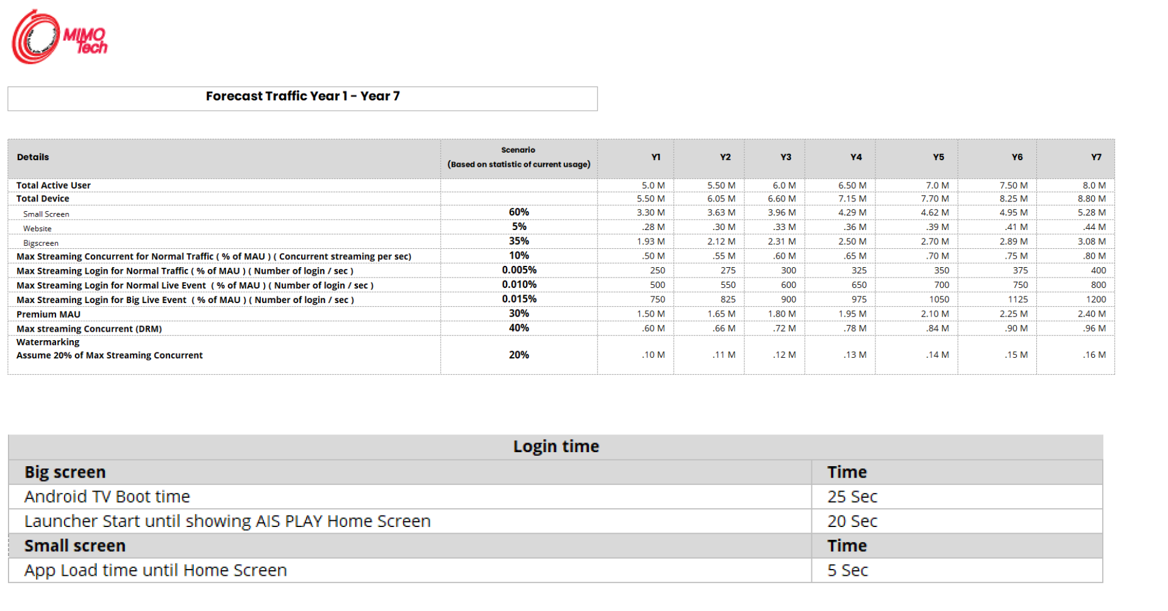
Apx. Calculation of standard capacity for this project
ㅇ 3BB standard capacity
Assuming that 200 tps per core can be processed, in case of 5 million, concurrent tps is calculated and reversed
Case1) 3BB
300,000 standard. Concurrent 10,000 . Interval 5 seconds = 2000 TPS
Case 2) AIS
500,000 concurrency based on 500 million, 5 seconds interval = 100,000 TPS
500,000 / 5 = 100,000 tps
Per core, when processing 200 TPS, PoD = 500

Slide 20
Apx. AWS APIGW vs BEAST
Division | AWS API G/W | BEAST API G/W
Monitoring | * Provide reduced monitoring information * Cloudwatch-based health monitoring | Building an integrated monitoring system for forcible DevOps implementation (e.g., API registration/deletion, statistics, speed bar, X-view ...) Providing API-integrated control monitoring specialized for user optimal/real-time/anomaly/failure Easy to reflect customer requirements
Develop domain-specific functions | Difficult to develop domain-specific features Unsupported Web-based development environment | Timely development/adoption of customer-requested features When integrating new OVP systems with legacy AIS, features such as data-format conversion and protocol conversions can be easily developed within the BEAST web portal.
Cost | * AWS API Gateway incurs high usage costs when API requests increase(burst-traffic). | No additional cost up to the TPS guaranteed when purchasing the license.
Maintenance | * Domain-specific development in the AWS API Gateway environment has a learning curve in the approach of general developers. | 24/7 maintenance by having a diagnosis development team of 20 people and solution delivery personnel

Slide 21
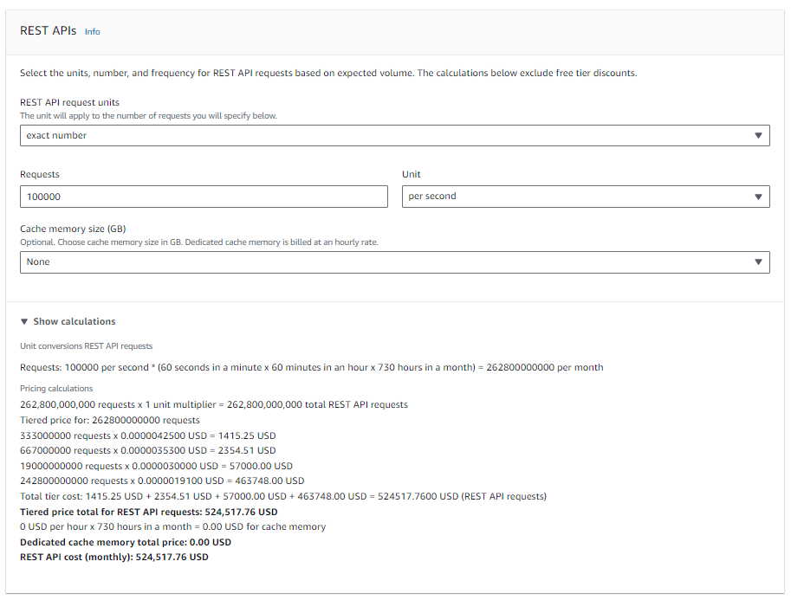
Apx. AWS APIGW Cost

Slide 22





Thank you
Copyright 2022 © MEGAZONECLOUD CORP. ALL RIGHT RESERVED.

